Slide 1


Salesforce – Moodle Integration

Slide 2









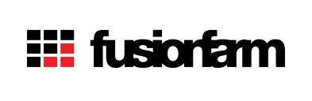

About Paradiso
In Business since 2007, based in Silicon Valley
Expert in eLearning Software and Content Creation
Clients in Education and Corporate Sector
Experts in LMS Software and Content Creation
Strong management team with many years of experience in Silicon Valley

Slide 3
Salesforce Moodle Integration
About Salesforce:
Salesforce.com is the enterprise cloud computing leader. Their social and mobile cloud technologies—including their flagship sales and CRM applications—help companies connect with customers, partners, and employees in entirely new ways.
About Moodle:
Moodle is an open-source Course Management System (CMS), also known as a Learning Management System (LMS) or a Virtual Learning Environment (VLE). It is a Free web application that educators can use to create effective online learning sites.

Slide 4

Salesforce-Moodle Integration Benefits
Benefits:
Increased participation in training by outside and inside sales teams
Student data helps in making internal and external marketing communications
Ability to track and promote partner and customer training
Increase productivity due to ease of use
HR has more visibility into usage of LMS by partners and salesforce
Increased revenue by selling courses online and tracking in CRM
HR can meet compliance and auditory needs
Easy access to training encourages goals of advancement
Reduced training costs/staff

Slide 5
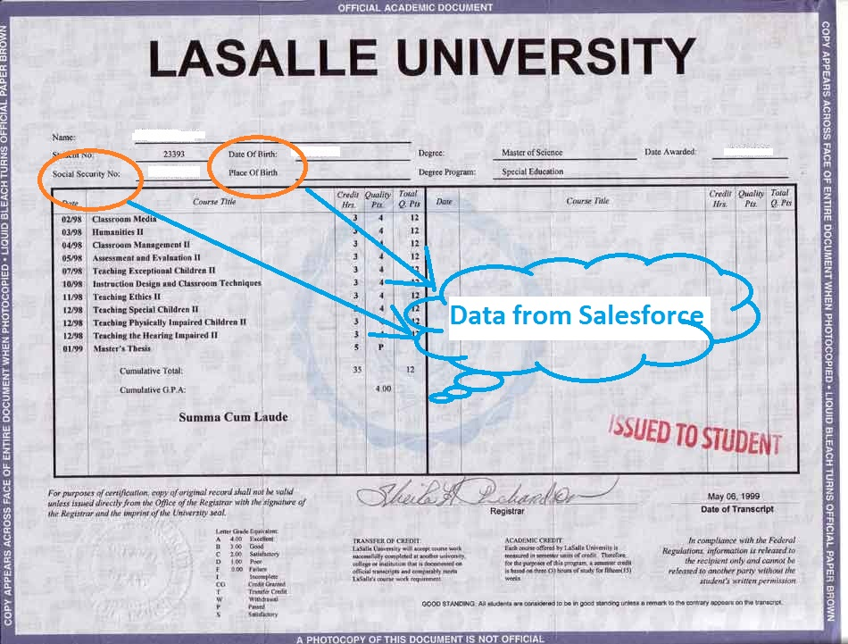
Salesforce ---> Moodle Integration Scenarios
In this scenario, Moodle access data from Salesforce.
  Salesforce data accessed in Moodle
    address , birth date, social security number
This data is used in Moodle for reporting or printing certificates etc.
  Controlled Access
    Check user type (Customer, Partner, Vendor etc) in Saleforce
    Accordingly give access to content in Moodle
By figuring out user types, one Moodle platform can be used by all the internal and external users.

Slide 6
Access to Salesforce Data inside Moodle
(Printing transcript inside Moodle)

Slide 7
Moodle → Salesforce Scenarios
In this integration Moodle data is accessed in Salesforce. Managers can assign courses to students/employees, they can see their course progress and much more. This data is stored in Moodle but accessed in Salesforce.
Training and Certifications results and statistics
Enrollment information
Account information: how many students in one particular account
Storage of certificates and transcripts for archiving purposes
Email marketing

Slide 8
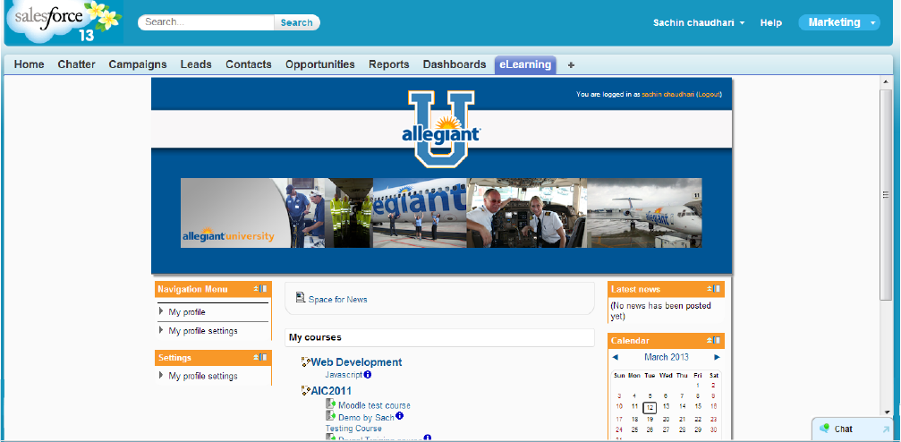
Use Case- SSO/Single Sign On
Single Sign-on from Salesforce: User logs into Salesforceand clicks on a button to get into LMS. They are automatically logged into Moodle without having to enter credentials.
Moodle

Slide 9
Use Case: Course Data Access in Salesforce
Course Completion data synchronization: Once the users are synchronized, the course data is also synchronized from Moodle into Salesforce. Every student in Moodle has contact record in Salesforce. When you look at the student contact record, you can see which courses they are assigned to , how much of the course they have completed, what are their scores etc. You can see basically all the student learning record within Salesforce.
    No duplicate user
    Easy Permissions and Roles
    Less Admin and Support work
    Easy user interface
    SSO- Single Sign On

Slide 10
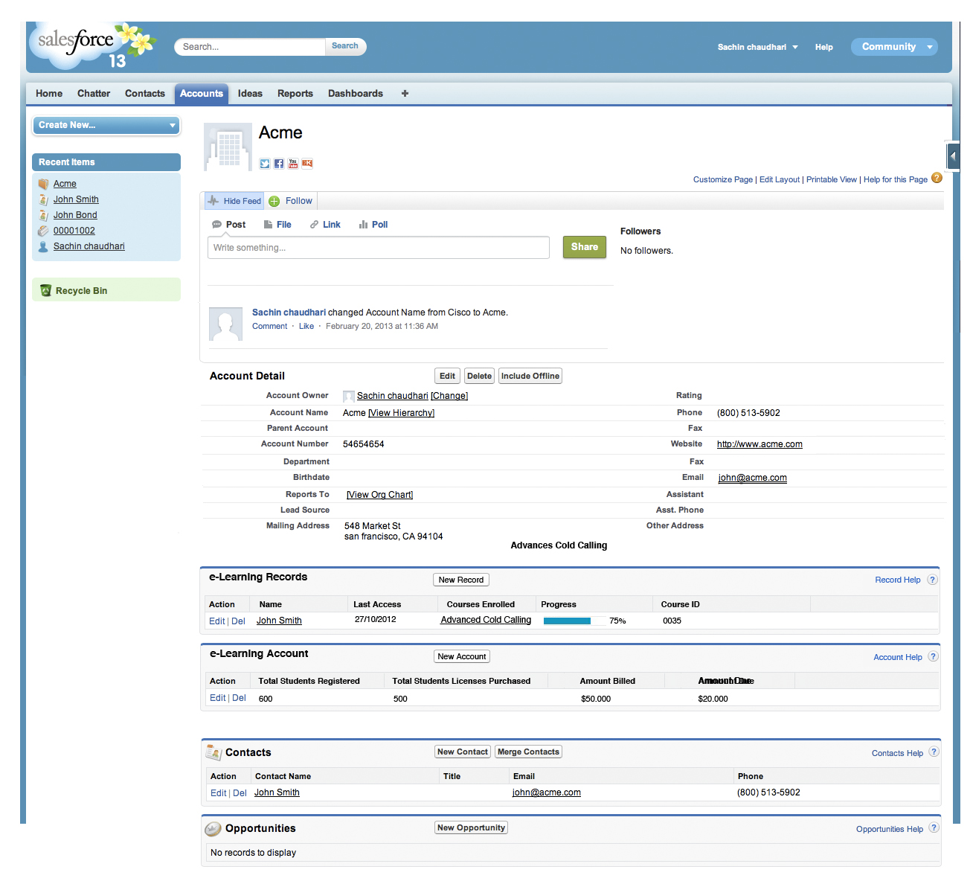

User data in Accounts Sync

Slide 11
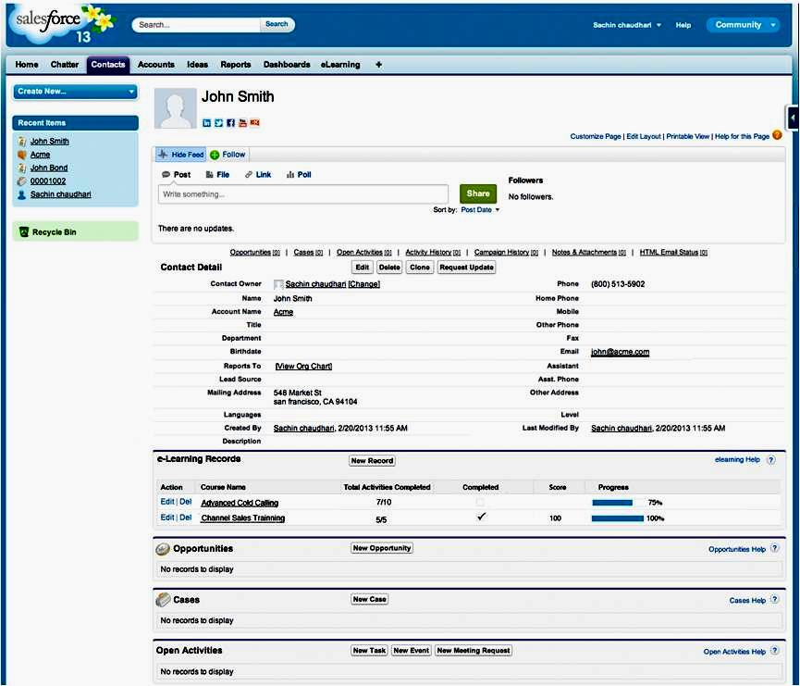
Course data Sync with Contacts

Slide 12


Use Case- Rule based Course Assignment
Rules Based Course Assignment: In this use case, depending on the role of the Salesforce user (such as partner, customer, reseller) they get assigned appropriate courses automatically in Moodle. For example partner gets courses A, B, C and reseller user gets course E, F, G. This is all done automatically based on user role.
One LMS Many Roles
  Partners
  Customers
  Employees
  Contractors
  Vendors
LMS PLATFORM
Partner
Customer
Employee

Slide 13

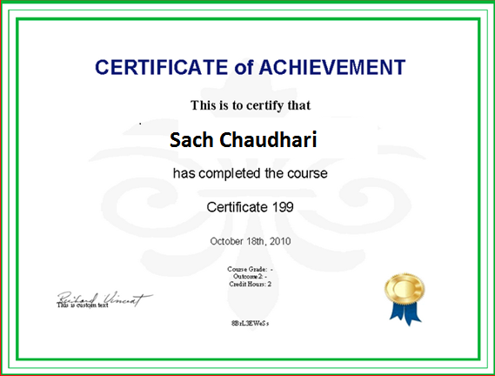
Use Case: Certificate/Transcript Record
Certificate/Transcript Record: Most often social security and address information of the student is stored in Salesforce but certificate is printed in Moodle. During the printing of the certificate from Moodle our integration fetches appropriate user data such as SSN and address and puts it on the Certificate. Then this certificate gets automatically emailed to the student from Moodle and also attached to the contact record in the Salesforce. That way manager can see student certificate or transcript within Salesforce. This also helps with compliance and archival needs. In case, Moodle record is deleted or Moodle is replaced by some other LMS then the certificate/transcript record still stays in Salesforce. If the student demands transcript after 10 years from graduation, a customer service rep can find it in Salesforcerecord and email it to the student.

Slide 14
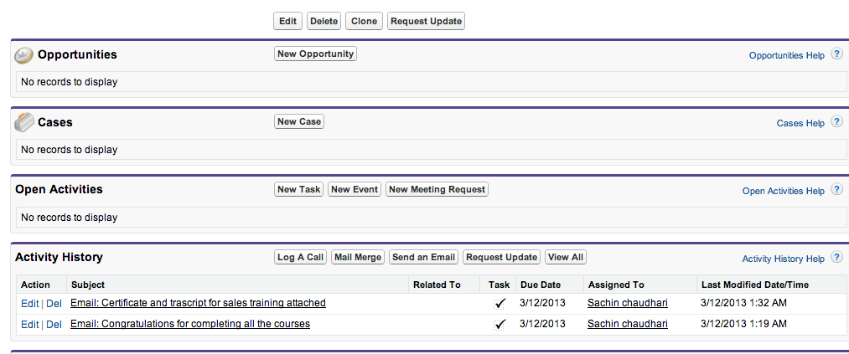

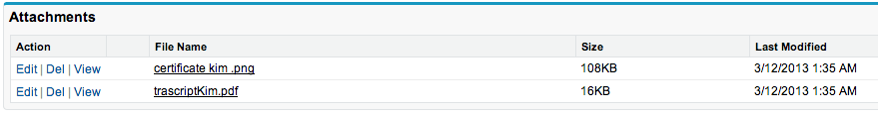
Certificate/Transcript Screenshot
Automatic attachment of Certificates and Transcripts to contacts
View transcript and Certicates from salesfroce even if LMS record is deleted

Slide 15
Use Case: User Synchronization
User Synchronization : When new user is created either in Salesforce or Moodle, our plugin checks if that user exists in other system, if it does and if any updates needed then the system does the updates. if the user does not exist then new record is created. This keeps the users in sync between 2 systems. Within Salesforce, the contact is also associated with appropriate account based on the domain of the user´s email address. For example, john@microsoft.com creates a contact called John in Salesforceand assigns it to Microsoft account.

Slide 16





Contact Us!
http://www.linkedin.com/company/paradiso-solutions
info@paradisosolutions.com
www.ParadisoSolutions.com
+1 800 513 5902
info_paradiso

